Slide 1
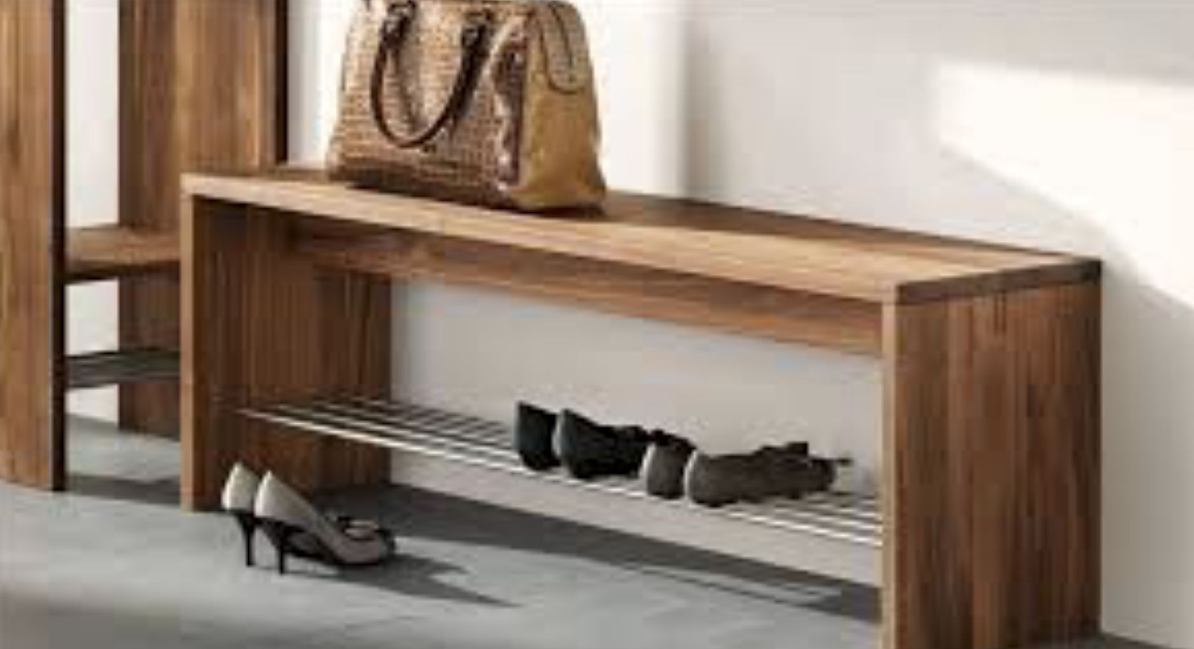
Acme Furniture
By: Eleanor Naff, Ashwin Murali, Keyu Chen, Rama Sonko, and Tyler West

Slide 2

Company Background
Largest furniture manufacturer in America
Traditionally heavy in brick & mortar storefronts
Fairly new to ecommerce
Affordable furniture offerings & ability to discount prices
Competitive in larger set piece furniture

Slide 3
Marketing Strategy
Our marketing strategy is to launch an ecommerce store for Acme Furniture that will rake in $125,000 in profit within six months.
We plan to employ various channels in which this ecommerce site will be promoted offering an alternative to the traditional brick and mortar design of Acme
While shoppers tend to still visit stores to look at furniture, Acme’s lack of presence in the ecommerce world puts in behind its competitors.
Ecommerce offers a new option to parents who are busy, may not have time to shop, or those who know exactly what they want to purchase to receive their items quickly and efficiently.

Slide 4
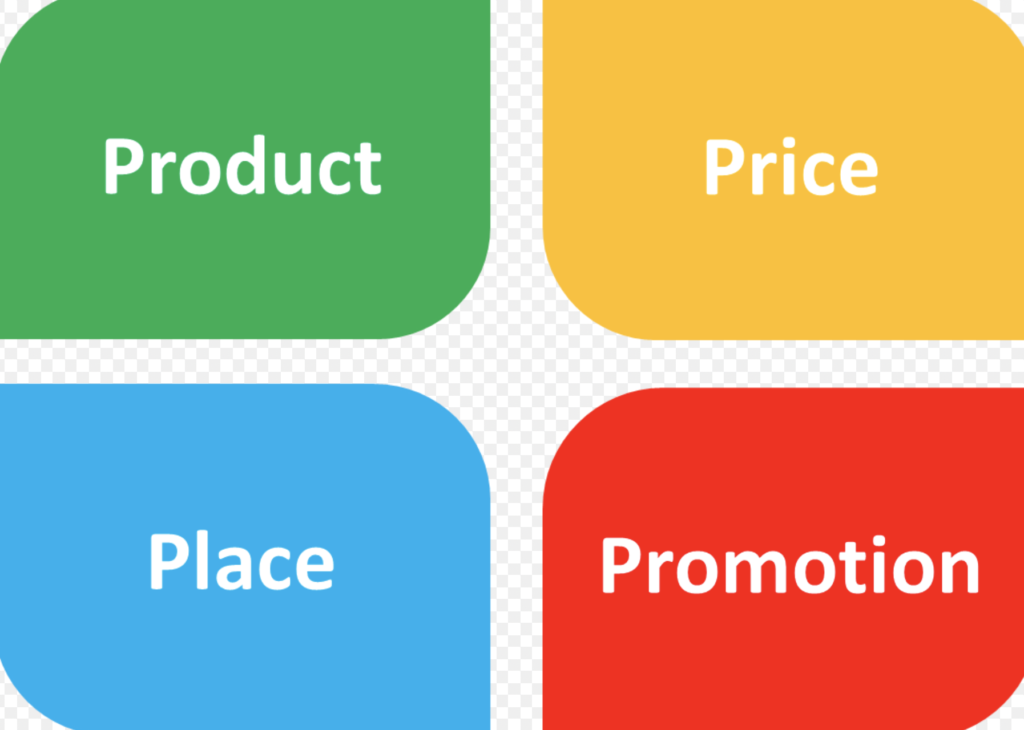
Four P’s of Marketing

Slide 5
Milestone Approach
3 Months: $75,000
Ability to adjust plan according to observed trends
Allows us to ensure the we are on track to meet our final goal
Over both periods, we only used channels with an ROAS value greater than $3 for Paid Search, Retargeting, and Paid Social, and over $1 for YouTube
6 Months: $125,000

Slide 6

Youtube
Target audience: 35-55, HHI $100-$250k
ROAS: $3.55
3 Months:
Cost: $3,000
Sales: $10,650
6 Months:
Cost: $3,000
Sales: $10,650
Impressions
Brick and Mortar Strength
Target audience: 25-40, HHI $50k-$200k
ROAS: $2.28
3 Months:
Cost: $2,000
Sales: $4,560
6 Months:
Cost: $2,000
Sales: $4,560

Slide 7




Paid Social
Target audience: 25-40, HHI $50k-$200k
ROAS: $3.05
3 Months:
Cost: $5,000
Sales: $15,250
6 Months:
Cost: $12,000
Sales: $36,600

Slide 8
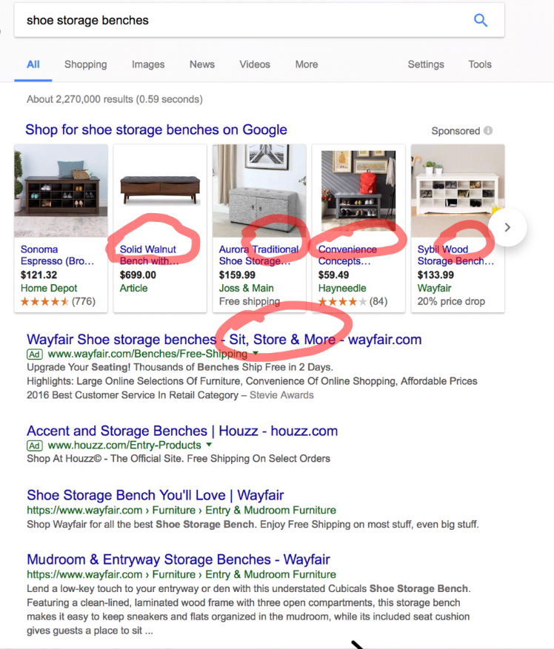
Paid Search
Target audience: 35-55, HHI $100k-$250k
ROAS: $4.47
3 Months:
Cost: $15,000
Sales: $67,050
6 Months:
Cost: $20,000
Sales: $89,400
Diminishing Returns
Key Words

Slide 9
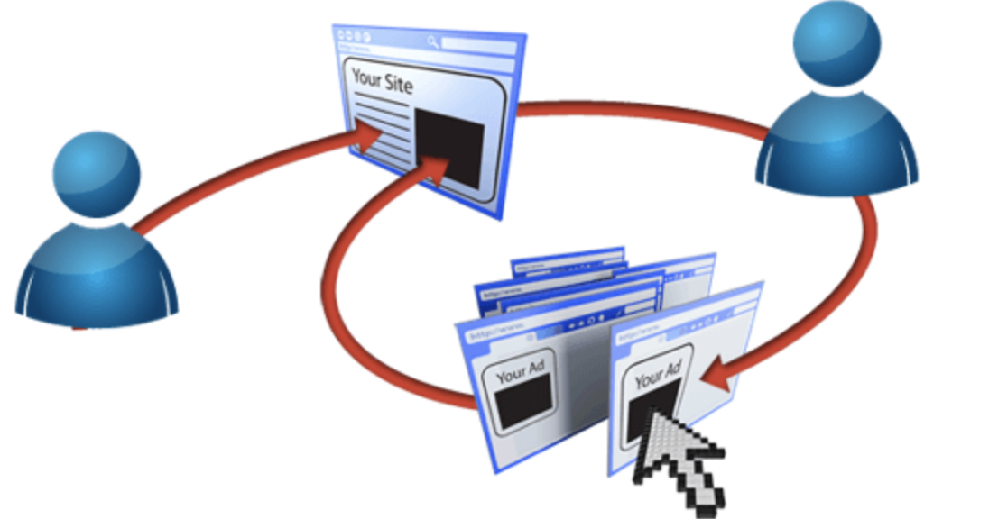
Retargeting
Target audience: 35-55, HHI $100-250k
Using website margins
ROAS: $3.09
3 Month
Wait on retargeting for first 3 months
6 Month
Cost: $5,000
Sales: $15,450

Slide 10
Conclusion
3 Month
Goal: $75,000
EComm Sales: $82,300
Total Sales: $97,510
Cost: $25,000
ROAS: 3.9
6 Month
Goal: $125,000
EComm Sales: $141,450
Total Sales: $156,660
Cost: $42,000
ROAS: 3.73
We should
Primary objective: Reach eComm sales volume of $125,000 per month, within six months
Secondary objective: Quality impressions to raise awareness for the new product line

